Slide 1

IDC605A: Project Presentation
Solving The Gross-Pitaevskii equation using spectral Methods
Rohit Ranjan
180629
dranjan@iitk.ac.in

Slide 2
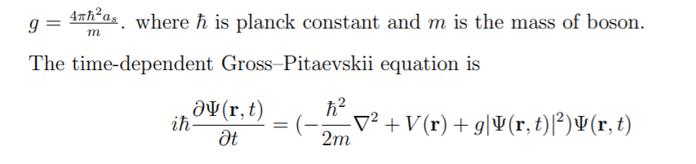
The Gross–Pitaevskii equation(GPE)
The equation has the form of the Schr¨odinger equation with the addition of an interaction term. The coupling constant g is proportional to the s-wave scattering length as of two interacting bosons:

Slide 3
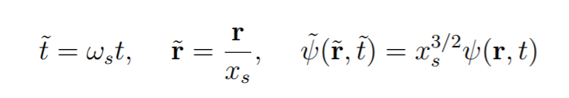
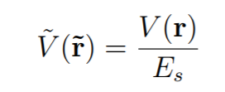
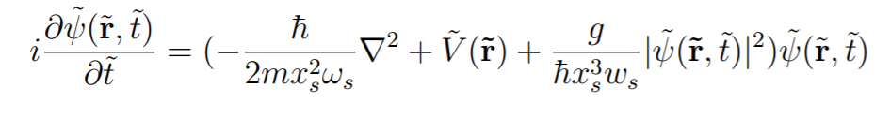
Dimensionless Equation
Choose following parameters

Slide 4
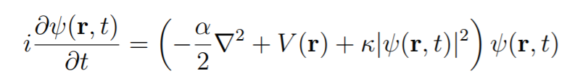
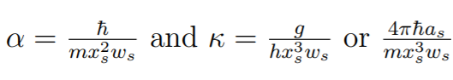
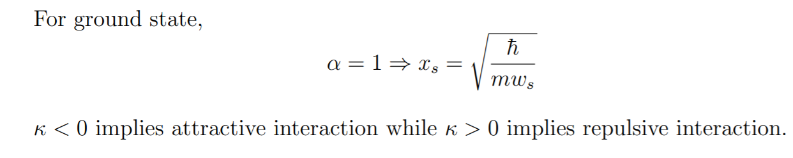
Dimensionless Equation

Slide 5
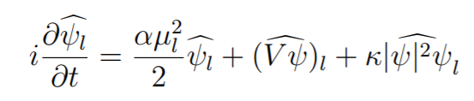
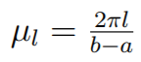
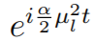
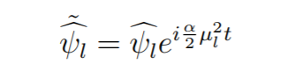
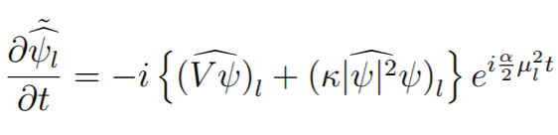
Solving Equation
Multiplying whole equation by

Slide 6
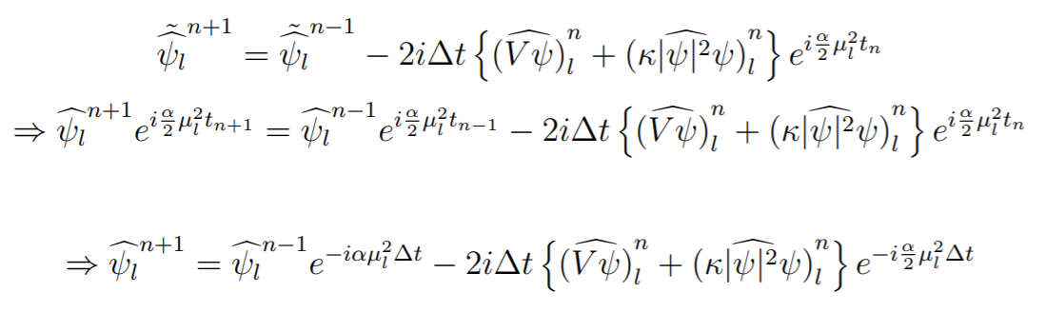
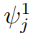
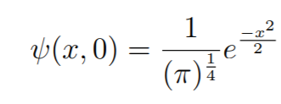
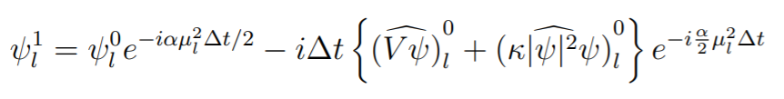
Leapfrog Method
Euler forward for

Slide 7
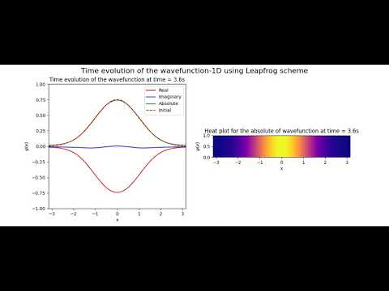
Leapfrog Simulations-1D

Slide 8
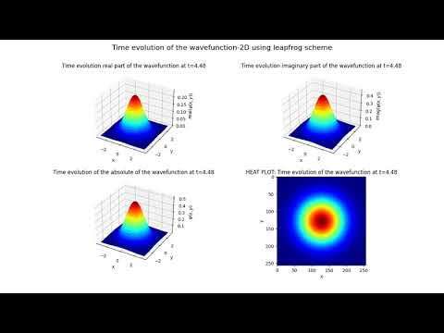
Leapfrog Simulations-2D

Slide 9
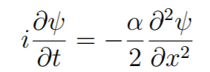
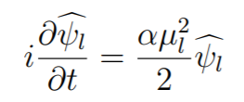
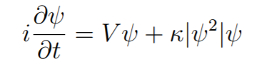
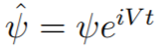
Tie Splitting
Fourier transformation:
First Part:
Now, ODE can be solved exactly.
Second part:
Again, this is an ODE, can be solved exactly. We can do following replacement

Slide 10
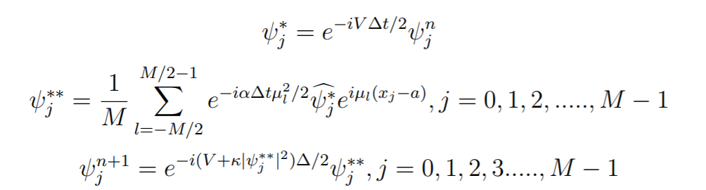
The Strang Splitting Spectral Method

Slide 11
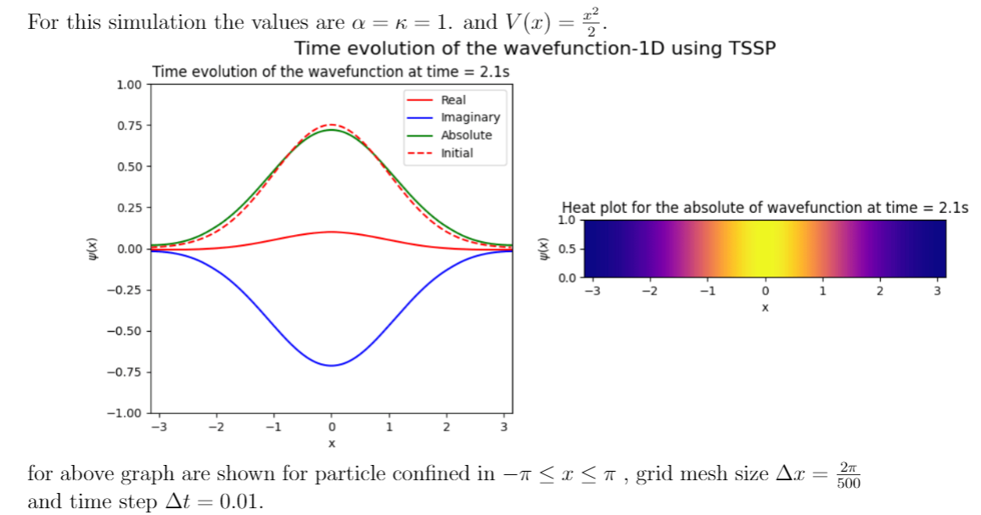
TSSP Result-1D
1-D
2-D

Slide 12
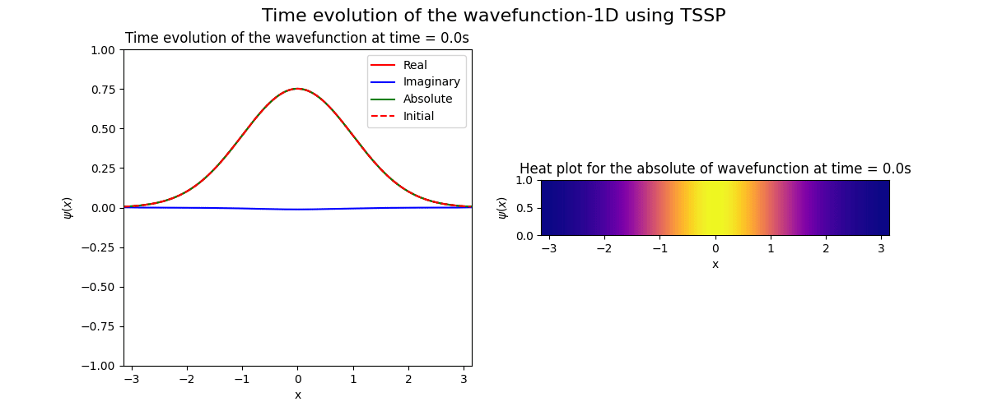
TSSP Simulations-1D
1-D
2-D

Slide 13
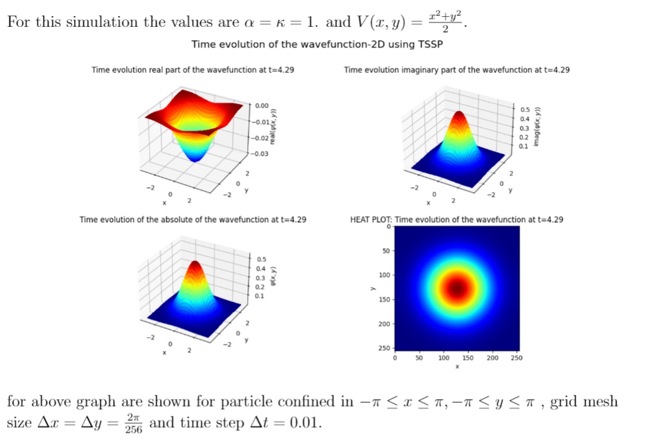
TSSP Result-2D
2-D

Slide 14
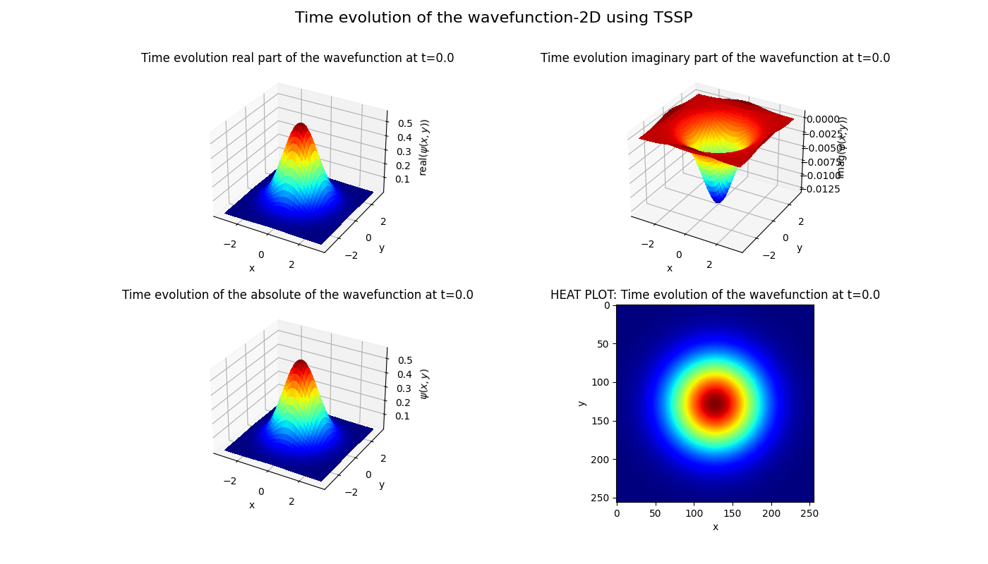
TSSP Simulations-2D

Slide 15
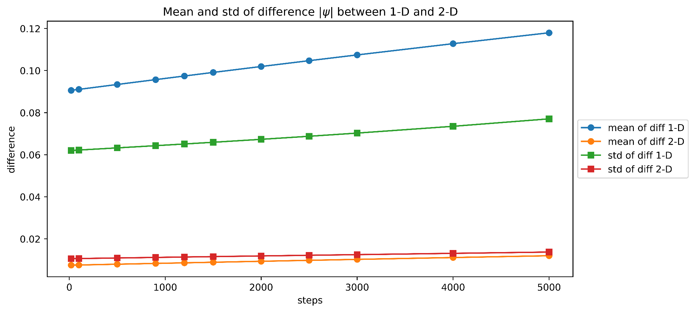
Comparison b/w Leapfrog and TSSP

Slide 16
Thank You!!

